Slide 1
Potato are nice, but…
How should I prove a program?
Model checking
SLAM, SPIN, BLAST …
Theorem proving
Automatic (Esc/Java, Spec# …)
Interactive (Isabelle, Coq …)
Abstract interpretation
Astree, ESP/X, Polyspace, Julia, Clousot …

Slide 2
Model checkers
P |= M
Explore a finite model
May not be enough
Predicate abstraction
Needs user-provided predicates
No way
Try to get them from the source code
Limited from the syntax
Very costly in practice
May not terminate
int x = 0, y = 2;
while (…)
{
x++; y++;
}
assert(y - x == 2);

Slide 3
Theorem provers
{Pre} C {Post}
Try to prove that Pre => wp(C, Post)
Nice in theory…
Practice
Limited inference abilities
E.g. Loop invariants
Need a lot of extra-annotations
More of what a programmer
is willing to pay
assume (N >= 0)
int i = 0, a = 0, b = 0;
while (i < N)
{
a++; b += 2; i++;
}
assert(a + b == 3 * N);

Slide 4
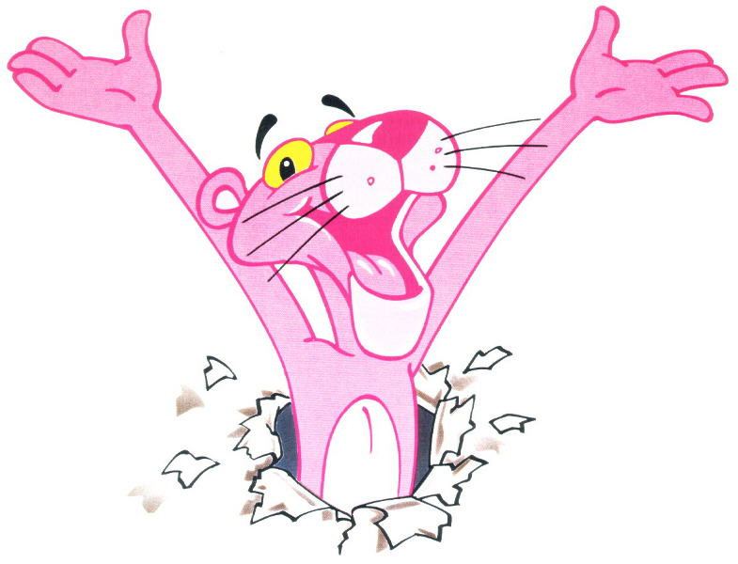
Static checker (Clousot)

Slide 5
Clousot
Based on Abstract Interpretation
≠ Usual approaches based on theorem prover
Advantages
Automatic
Inference of loop invariants, pre, post, invariants
Predictable
No quantifier instantiation
No easy proofs by contradictory axioms
Scalable
Tune-up for the properties of interest

Slide 6
Algorithm: High level
For each assembly A
For each class C
For each method M
Extract the proof obligations
What should I prove?
Run the analyses
Discover facts on the program
Use the facts to prove the proof obligations
If not, do something else… (next Monday)

Slide 7
Proof obligations
Two kinds: Implicit and explicit
Implicit
NonNull checking
Bounds checking
Divisions by zero, overflow
…
Explicit
Assertions
When calling a method, its precondition
When returning from a method, its postcondition

Slide 8
NonNull dereference
public bool IsCiao(string s)
{
return s.Contains("ciao!");
}
The string s should not be null
Otherwise, exception at run time
Clousot scans the program and records the proof obligation:
s != null

Slide 9
Array bounds
public int[] RandomArray(int len)
{
var random = new Random(len);
var arr = new int[len];
for (var i=0; i < len; i++)
{
arr[i] = random.Next();
}
return arr;
}
Len >= 0
i < arr.Length
i >= 0

Slide 10
Overflows
public int Abs(int x)
{
if (x < 0)
return -x;
return x;
}
public int Div(int x, int y)
{
return x / y;
}
y != 0
x != MinValue
x != MinValue || y != -1

Slide 11
Explicit obligation: Assertions
public string Concat(string p, string q)
{
Contract.Requires(p != null);
Contract.Requires(q != null);
var concat = p + q;
Contract.Assert(concat != null);
Contract.Assert(concat.Length > 0);
return concat;
}
concat != null
concat.Length > 0

Slide 12
Assume/guarantee reasoning
Have methods M, N
M with precondition P, postcondition Q
If P is true, then M guarantees Q
If N calls M then
N should establish P
N can rely on Q

Slide 13
Preconditions
public string Concat(string p, string q)
{
Contract.Requires(p != null);
Contract.Requires(q != null);
// …
}
public string MyConcat()
{
return Concat("Ciao", null);
}
Concat “believes”
(assumes)
those preconditions
“Ciao” != null
null != null

Slide 14
Postconditions
public double Abs(double x)
{
Contract.Ensures(
Contract.Result<double>() >= 0);
if (x < 0)
return -x;
return x;
}
public double Sqrt(double z)
{
return Math.Sqrt(Abs(z));
}
-x >= 0
x >= 0
Sqrt “believes”
(assumes)
Abs(z) >= 0

Slide 15
Read the bytecode

Slide 16
Phase 1
Read the program from the disk
Bytecode format
Bytecode is stack based
Get rid of the stack
Program in 3 addresses form
Build the control flow graph
Get rid of Heap
Scalar program

Slide 17
On the disk…
.Dll or .Exe
Metadata
(attributes?)
Metadata
(bitmaps?)
Code
Class
Method 1 (constructor?)
Method 2
Method 3

Slide 18
.NET
Safe execution environment
Managed execution, GC …
Object-oriented
Shared type system
C#
VB
F#
…
Managed C++
Common Intermediate Language (CIL)
Libraries (mscorlib, System.dll …)
Virtual Machine
Operating System (Windows …)

Slide 19
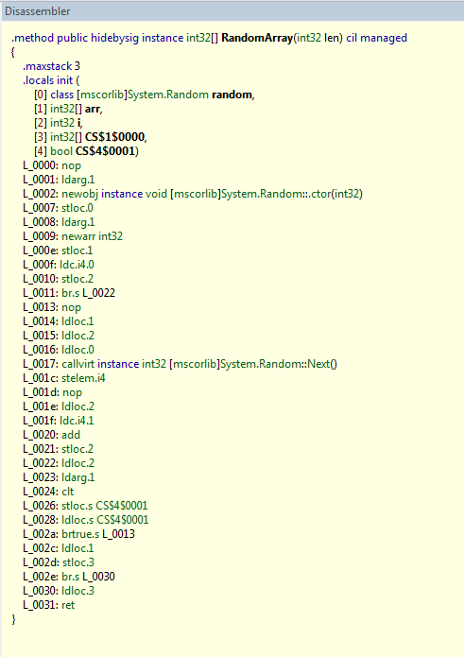
Bytecode
public int[] RandomArray(int len)
{
var random = new Random(len);
var arr = new int[len];
for (var i=0; i < len; i++)
{
arr[i] = random.Next();
}
return arr;
}
C# compiler

Slide 20
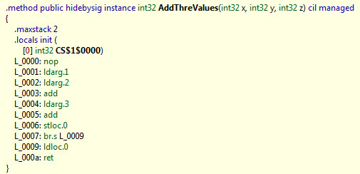
Bytecode is ugly to analyze
public int AddThreValues(int x, int y, int z)
{
return x + y + z;
}

Slide 21
So why we analyze it?
It’s common
Output of C#, F#, VB … compilers
i.e. millions of programmers…
Languages change, bytecode not
C# 2.0 -> C# 3.0 -> C# 4.0
Semantics of bytecode is fix
Closest thing we have to a formal specification
Do not need the source code to analyze

Slide 22
De-stack
Make the stack locations explicit
public int DeStack(int x, int y, int z)
{
int stack; // Stack
int CS_1_0000; // CS$1$0000 is an invalid C# name
stack = x + y;
stack = stack + z;
CS_1_0000 = stack;
return CS_1_0000;
}

Slide 23
De-stack
Syntactic transformation
Input
Stream of instructions for a method
Output
Stream of instructions in one of the forms
R = R1 binop R2
where binop ∈ { +, -, *, /, %, ≥, ≤ > , … }
R = unop R1
Where unop ∈ { -, (int32), (int64) …}
Jump label, ret value
Where jump is { jz, jnz, … }
Call method

Slide 24
Control flow graph construction
Method entry
assume Pre(f)
entry
entry

Slide 25
Control flow graph construction
Method exit
assert Post(f)
ret v
ret v

Slide 26
Control flow graph construction
Method call
assert Pre(f)
Call f()
Call f()
assume Post(f)

Slide 27

Control flow graph construction
Jumps
jump l
istr 1
…
istr n
jump j
l:
istr n+1
…
istr k
j:
istr 1
…
istr n
l:
istr n+1
…
istr k
j: …
A sequence of non-jump instructions is a block

Slide 28
De-Heap
Variables can alias
public class Alias
{
int x;
public void Foo(bool b)
{
Alias tmp = new Alias();
tmp.x = -11;
Alias alias = tmp;
if(b)
{
alias.x = 10;
}
Contract.Assert(tmp.x == -11);
}
}
alias and tmp alias!
Is it true?

Slide 29
De-heap
Goal:
Remove the heap
Assign a name to each heap location
Input:
A program in 3 addresses form
Output:
A program without explicit heap locations
All variables are assigned at least once (SSA)
Idea:
Track equalities

Slide 30
An example
public class Alias
{
int x;
public void Foo(bool b)
{
Alias tmp = new Alias();
tmp.x = -11;
Alias alias = tmp;
if(b)
{
alias.x = 10;
}
Contract.Assert(tmp.x == -11);
}
}
public class AliasScalar
{
public void Foo(bool b)
{
int svX = -11;
if (b)
{
svX = 10;
}
Contract.Assert(svX == -11);
}
}
Use e-graph
At the blackboard

Slide 31
That’s all for today

Slide 32
Let’s recap
We’ve seen:
Contracts
Documentation
Better debugging
Assume/guarantee reasoning on the code
Clousot
Collect proof obligations
Implicit/explicit
Bytecode analysis
De-Stack
CFG construction
De-Heap

Slide 33
Next
Expression recovery
Numerical abstract domains in Clousot
Pentagons
Combination of domains
Subpolyhedra
Hints
Floating points
Backward analysis
Inter-method inference
Message prioritization and filtering

Slide 34
Ciao!

